Slide 1
CS 540 Network Architecture
Lecture 8: Fair Queueing
Prof. Younghee Lee
Some part of this teaching materials are prepared referencing the lecture note made by F. Kurose and Keith W. Ross

Slide 2
Revisiting QoS issues with SDN concept?
Data plane becomes no longer merely forwarding
Can control network
Can get states
Caching
IDS
Network Virtualization
Certain application requires certain QoS
Delay, Bandwidth, Jitter, Error rate, …
=> Fair queueing technologies are required

Slide 3

Principles for QOS guarantees (more)
what if applications misbehave (VoIP sends higher than declared rate)
policing: force source adherence to bandwidth allocations
marking, policing at network edge
1 Mbps
phone
R1
R2
1.5 Mbps link
packet marking and policing
Principle 2
provide protection (isolation) for one class from others
Slides made by F. Kurose and Keith W. Ross

Slide 4
Principles for QOS guarantees (more)
allocating fixed (non-sharable) bandwidth to flow: inefficient use of bandwidth if flows doesn’t use its allocation
1 Mbps
phone
1 Mbps logical link
R1
R2
1.5 Mbps link
0.5 Mbps logical link
Principle 3
while providing isolation, it is desirable to use
resources as efficiently as possible
Slides made by F. Kurose and Keith W. Ross

Slide 5
Scheduling and policing mechanisms
scheduling: choose next packet to send on link
FIFO (first in first out) scheduling: send in order of arrival to queue
real-world example?
discard policy: if packet arrives to full queue: who to discard?
tail drop: drop arriving packet
priority: drop/remove on priority basis
random: drop/remove randomly
packet
arrivals
packet
departures
queue
(waiting area)
link
(server)
Slides made by F. Kurose and Keith W. Ross

Slide 6
Scheduling policies: priority
priority scheduling: send highest priority queued packet
multiple classes, with different priorities
class may depend on marking or other header info, e.g. IP source/dest, port numbers, etc.
real world example?
high priority queue
(waiting area)
arrivals
departures
classify
link
(server)
low priority queue
(waiting area)
can be staved!!!
2
1
3
4
5
arrivals
packet in service
1
3
2
4
5
departures
1
3
2
4
5
Slides made by F. Kurose and Keith W. Ross

Slide 7
Scheduling policies: still more
Round Robin (RR) scheduling:
multiple classes
cyclically scan class queues, sending one complete packet from each class (if available)
real world example?
2
1
3
4
5
arrivals
packet in service
1
3
2
4
5
departures
1
3
3
4
5
Slides made by F. Kurose and Keith W. Ross

Slide 8
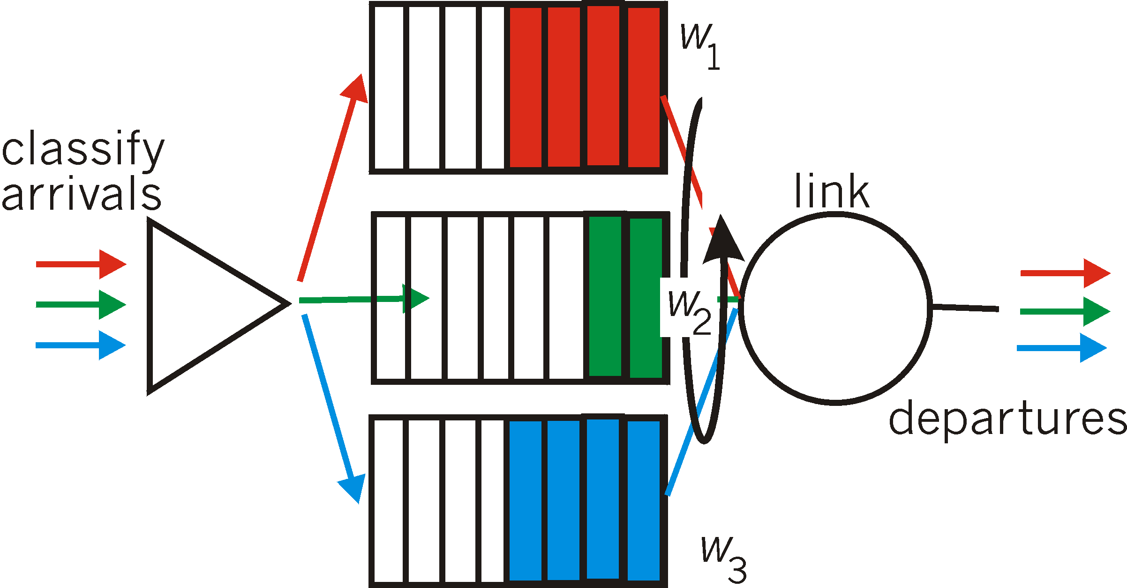
Scheduling policies: still more
Weighted Fair Queuing (WFQ):
generalized Round Robin
each class gets weighted amount of service in each cycle
real-world example?
Slides made by F. Kurose and Keith W. Ross

Slide 9
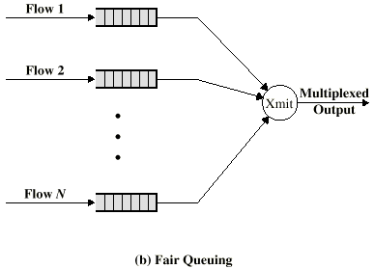
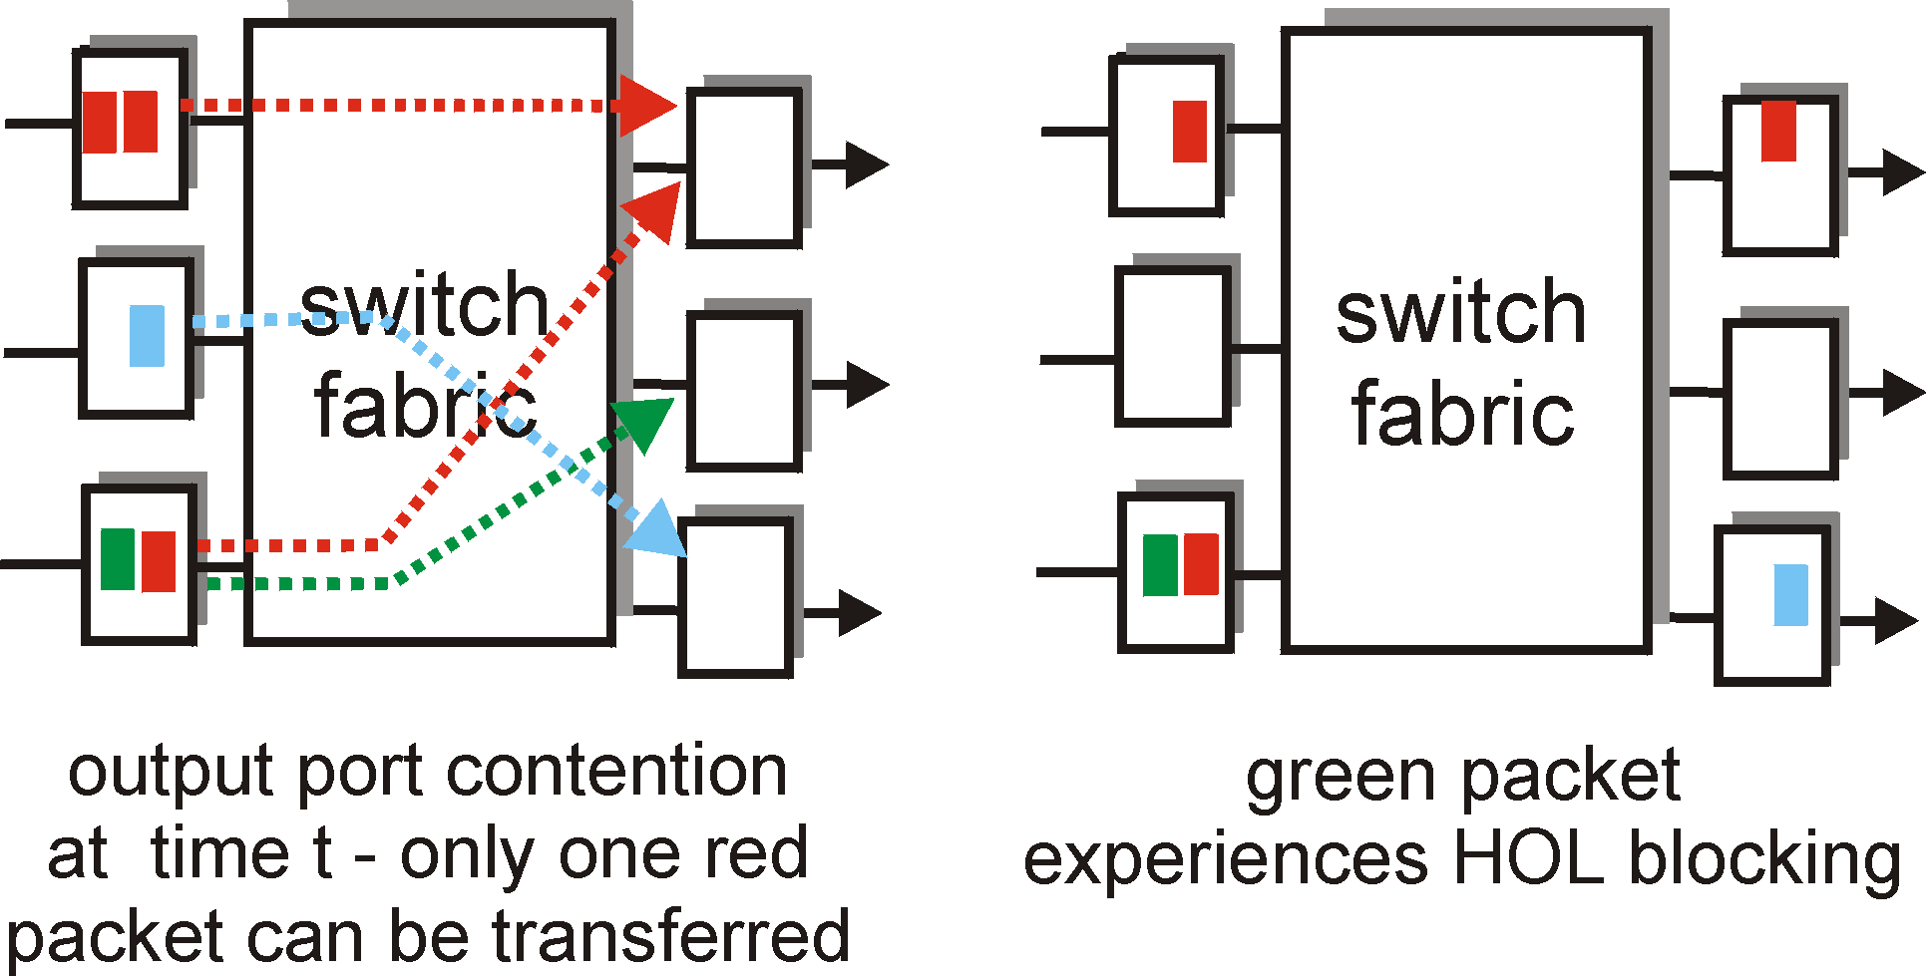
Scheduling
Scheduler
Classifier
Buffer management
Drawbacks to the FIFO queuing discipline
No special treatment to

Slide 10
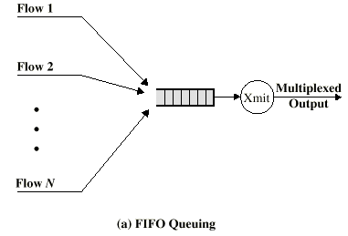
Queuing discipline
Drawbacks to the FIFO queuing discipline
No special treatment to packets from flow of higher priority such as delay sensitive traffic flow
larger average delay per packet than if the shorter packets were transmitted before the longer packet. Flows of larger packets get better service
A greedy TCP connection can crowd out altruistic connections. Ex) RTO backoff in congestion
Fair Queuing
A router maintains multiple queues at each output port
round robin, skip over empty queues. Load-balancing, protect greedy..
But poor sharing => low utilization, longer average queueing delay
Think of traffic shaping by token bucket => may not be poisson

Slide 11
Max-Min Fair Share
Allocate user with “small” demand what it wants, evenly divide unused resources to “big” users
Resources are allocated in order of increasing demand
No source gets a resource share larger than its demand
Sources with unsatisfied demands get an equal share of the resource
Example
Demand: x₁< x₂<, …. <x_{n}, Server capacity: C
Give C/n to x₁; if this is more than X₁ wants, divide excess (C/n - x₁) to other sources: => each gets C/n + (C/n - x₁)/(n-1)
If this is larger than what x₂ wants, repeat process
Allocation with weights
(C/n)*W_{i} /Sum(W_{i})
Implementing Max-Min Fair Share
Simple round robin has problem => variable packet length
Link: 30
{12.10.9}
3
2
1

Slide 12
Processor sharing
Drawbacks of fair queuing scheme
Short packet are penalized
one packet per cycle
Processor sharing
transmit one bit from each queue on each round
not practical to implement
BRFQ
designed to emulate PS
rule: whenever a packet finishes transmission, the next packet sent is the one with the smallest value of .

Slide 13
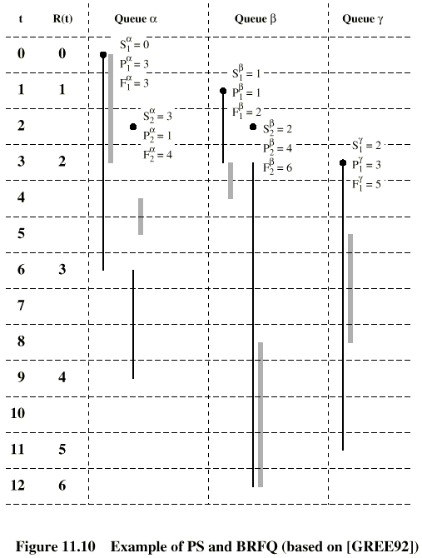
Processor sharing
PS
BRFQ

Slide 14
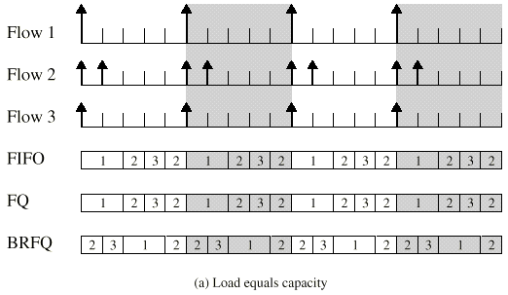
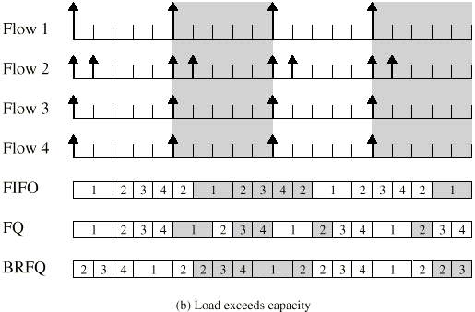
Bit-round Fair Queuing(BRFQ)
BRFQ
solve the problem in FQ: “short packet are penalized”
BRFQ: uses packet length as well as flow identification
Good approximation to the performance of PS. Figure 11.10

Slide 15
Generalized Processor Sharing
Motivation
BRFQ can’t provide different amount of the capacity to different flows.
Differential allocation capacity;
To support QoS transport
GPS
provides a means of responding to different service requests
each flow α is assigned a weight φ_{α} that is the number of bits transmitted from the queue during each round.

Slide 16
Weighted Fair Queuing(WFQ)
WFQ
provide different amount of the capacity to different flows.
designed to emulate GPS
rule: whenever a packet finishes transmission, the next packet sent is the one with the smallest value of .

Slide 17
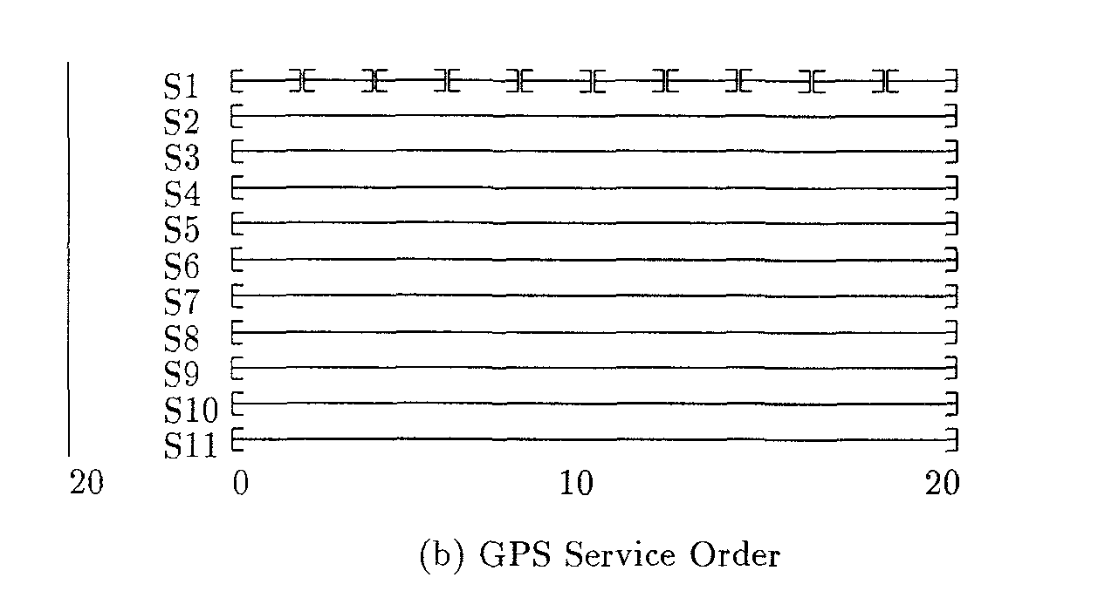
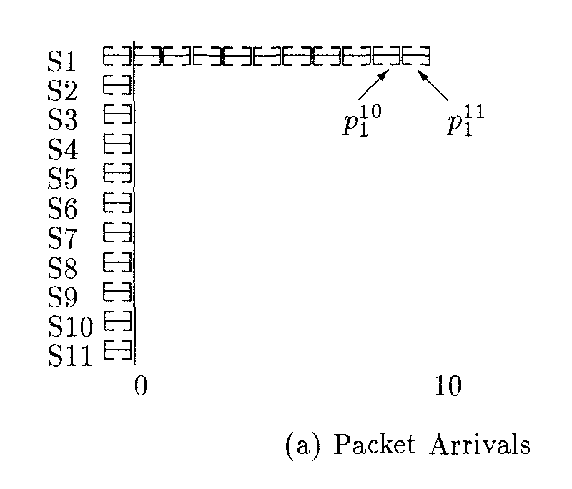
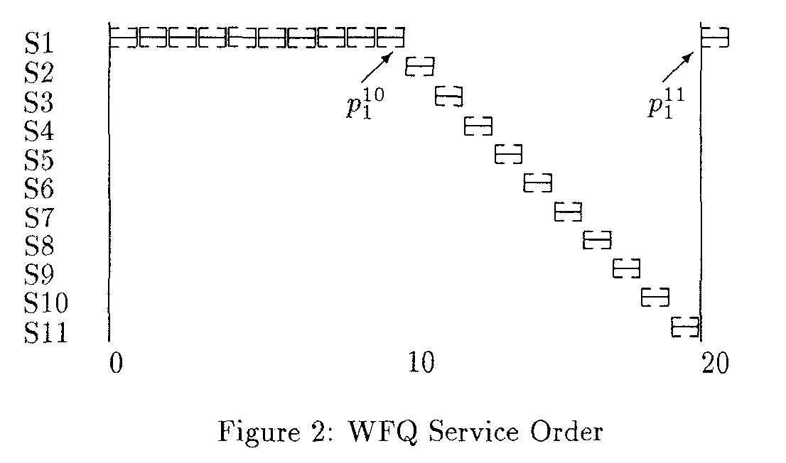
Problems with WFQ
Large differences between flows
WFQ might be well ahead of GPS!!

Slide 18
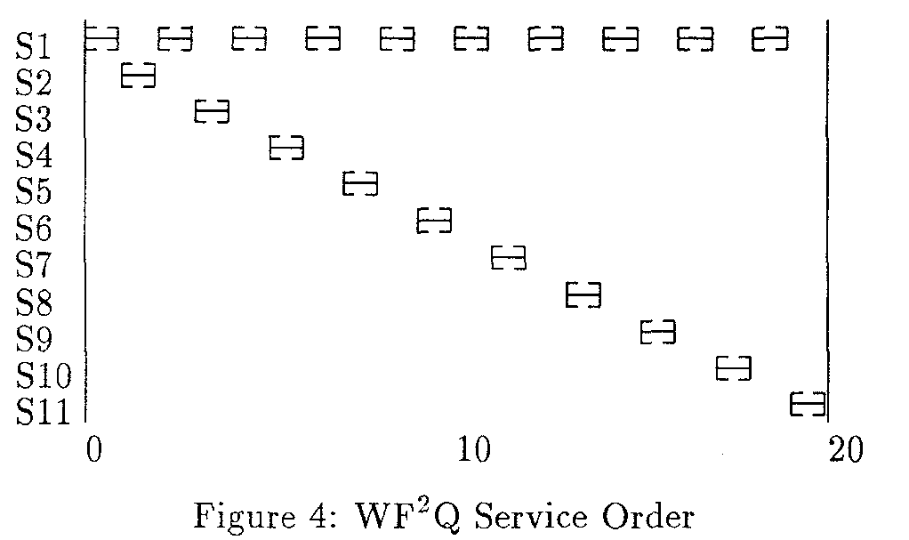
WF²Q: Worst-case Fair Weighted Fair Queueing
WF²Q scheduler considers
only packets that have started in the emulated GPS system
Get closer emulation of GPS
provides almost identical service to GPS differing by no more than one maximum size packet
add lower bound on the time difference with GPS
“Run-ahead” of WF²Q also limited to fraction of max packet size

Slide 19
Processor sharing
PS
BRFQ

Slide 20
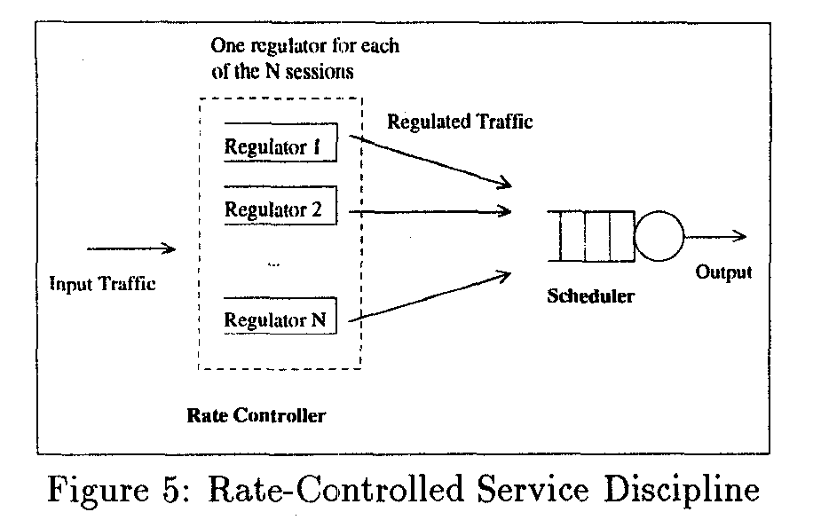
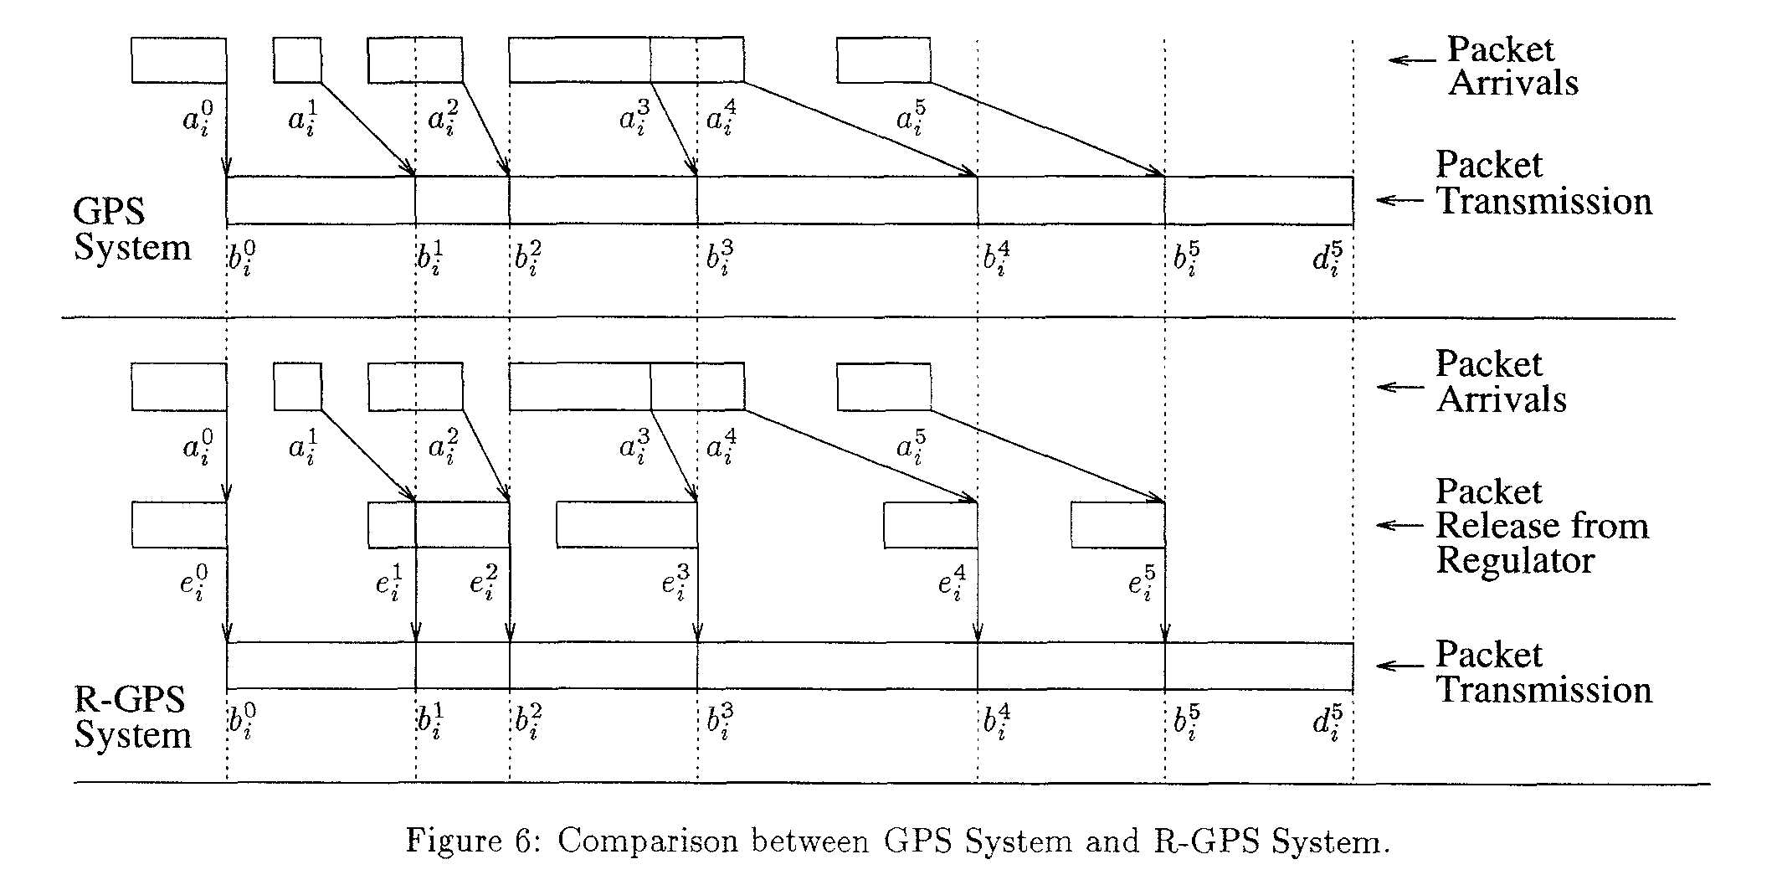
WF²Q
Packet need to be delayed by regulator
Packet should arrive at the last possible moment
Scheduler gets packets just in time
Delay until GPS would have started the packet
Scheduler can be WFQ

Slide 21
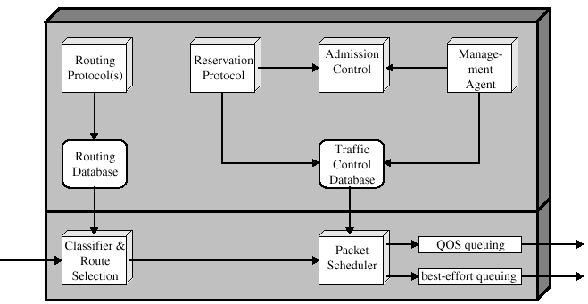
ISA & DS for QoS
ISA: Integrated Service Architecture
QoS over IP
e.g.) RSVP: Too complex to deploy
ISA

Slide 22
ISA Components
Background functions:
Reservation protocol: to reserve resources for a new flow
Admission control: to determine if sufficient resources are available
deciding when the addition of new people would result in reduction of utility
To avoids overload
Forwarding functions:
Classifier and route selection: mapping into classes
ex) the packets of all video flows may be treated identically
Packet scheduler: manages one or more queues. Deciding how to treat the excess packets

Slide 23
ISA Services
ISA service level
a number of general categories of service are provided
Guaranteed
provides assured capacity level or data rate
Control load
a very high percentage of transmitted packets will be successfully delivered: useful for adaptive real-time applications
Best effort
Flow Spec.: parameters to specify the service for a flow:
Traffic specification(Tspec): include token bucket parameter(token rate, bucket size)
Request specification(Rspec): Guaranteed, Controlled load, Best effort

Slide 24
Policing mechanisms
goal: limit traffic to not exceed declared parameters
Three common-used criteria:
(long term) average rate: how many pkts can be sent per unit time (in the long run)
crucial question: what is the interval length: 100 packets per sec or 6000 packets per min have same average!
peak rate: e.g., 6000 pkts per min (ppm) avg.; 1500 ppm peak rate
(max.) burst size: max number of pkts sent consecutively (with no intervening idle)
Slides made by F. Kurose and Keith W. Ross

Slide 25
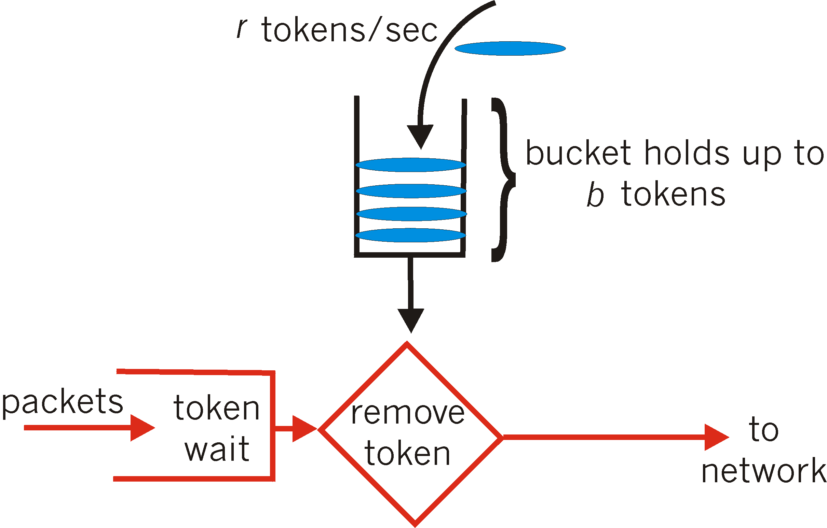
Policing mechanisms: implementation
token bucket: limit input to specified burst size and average rate
bucket can hold b tokens
tokens generated at rate r token/sec unless bucket full
over interval of length t: number of packets admitted less than or equal to (r t + b)
Slides made by F. Kurose and Keith W. Ross

Slide 26
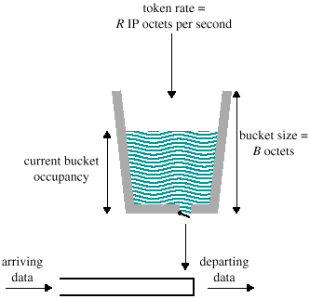
Token Bucket Traffic Spec.
A token replenishment rate R: specifies the continually sustainable data rate
A bucket size B: specifies the amount by which the data rate can exceed R for short period of time
During any time period T, the amount of data sent cannot exceed RT + B
Bucket: represent a counter that indicates the allowable number of octets
Bucket fills with octet tokens at the rate of R
When insufficient tokens available
common actions: relegating the packet to best-effort service or buffered for later transmission or discarding the packet,….
λ_{p} :peak rate, λ_{a} :average rate, R :token rate
λp > R > λa:
Maximum burst size: b’
b(t)= b + (R - λ_{p} ) x t : assuming token is full at the beginning
0 = b + (R - λ_{p} ) x t -> t = b/(λ_{p} - R )
b’ = λ_{p} * t = b /(1- R / λ_{p})

Slide 27
ISA
Possible Token Bucket Uses
Shaping, policing, marking
Delay pkts from entering net (shaping)
Drop pkts that arrive without tokens (policing)
Let all pkts pass through, mark ones without tokens (marking)
Network drops pkts without tokens in time of congestion
QoS
Leaky Bucket rate control + WFQ(at network node)
Isolation: Isolate well-behaved traffic from misbehaving sources
WFQ: good but poor sharing
FIFO: good for sharing but poor isolation
Mixing with FIFO (e.g. GRR) => good but high complexity
Guarantee end to end delay: < B/R (R may be larger than average rate)

Slide 28
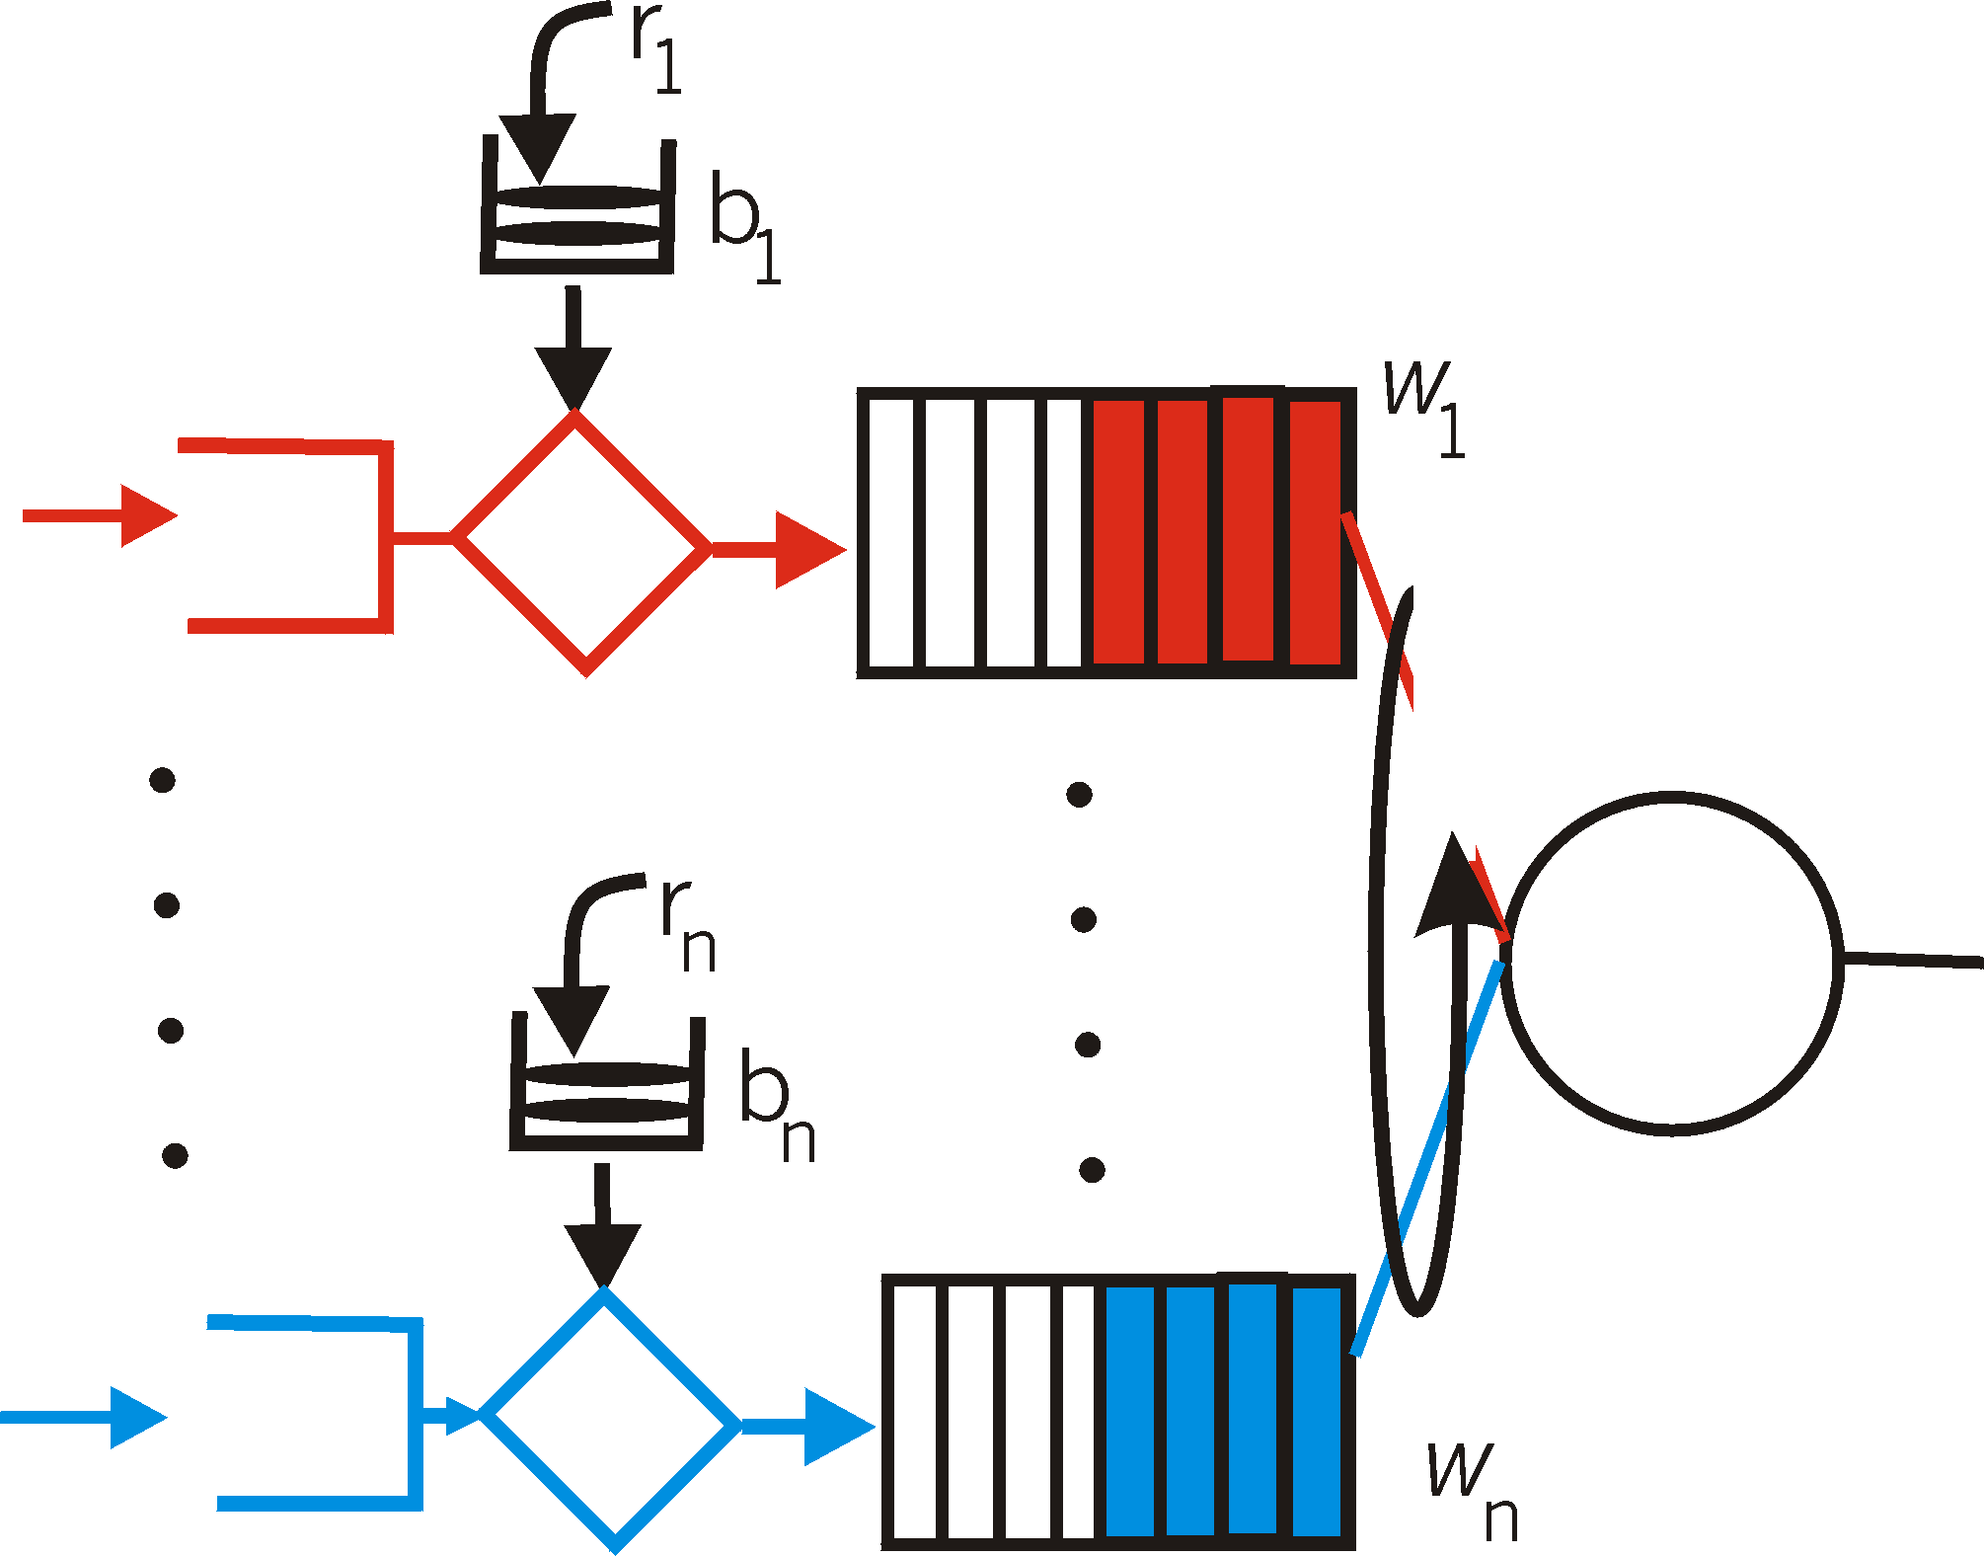
Policing and QoS guarantees
token bucket, WFQ combine to provide guaranteed upper bound on delay, i.e., QoS guarantee!
arriving
traffic
token rate, r
bucket size, b
per-flow
rate, R
WFQ
D = b/R
arriving
traffic
max
Slides made by F. Kurose and Keith W. Ross

Slide 29
Differentiated services
want “qualitative” service classes
“behaves like a wire”
relative service distinction: Platinum, Gold, Silver
scalability: simple functions in network core, relatively complex functions at edge routers (or hosts)
signaling, maintaining per-flow router state difficult with large number of flows
don’t define define service classes, provide functional components to build service classes
Slides made by F. Kurose and Keith W. Ross

Slide 30
Differentiated Services
Service Level Agreement(SLA): an agreement between a customer and the DS domain. TCA is a subset of SLA
other details: Routing constraint, encryption requirements etc.
Edge routers are responsible for interfacing with the customers by executing SLAs
Bandwidth Broker helps the Edge routers in the admission control of the SLAs.
Per-Hop behavior
a description of the externally observable forwarding behavior of a DS node applied to a particular DS behavior aggregate
Expedited Forwarding: can be used to construct services with quantitative guarantees
Assured Forwarding
four classes: each class is guaranteed to be provided with some minimum amount of bandwidth and buffering

Slide 31
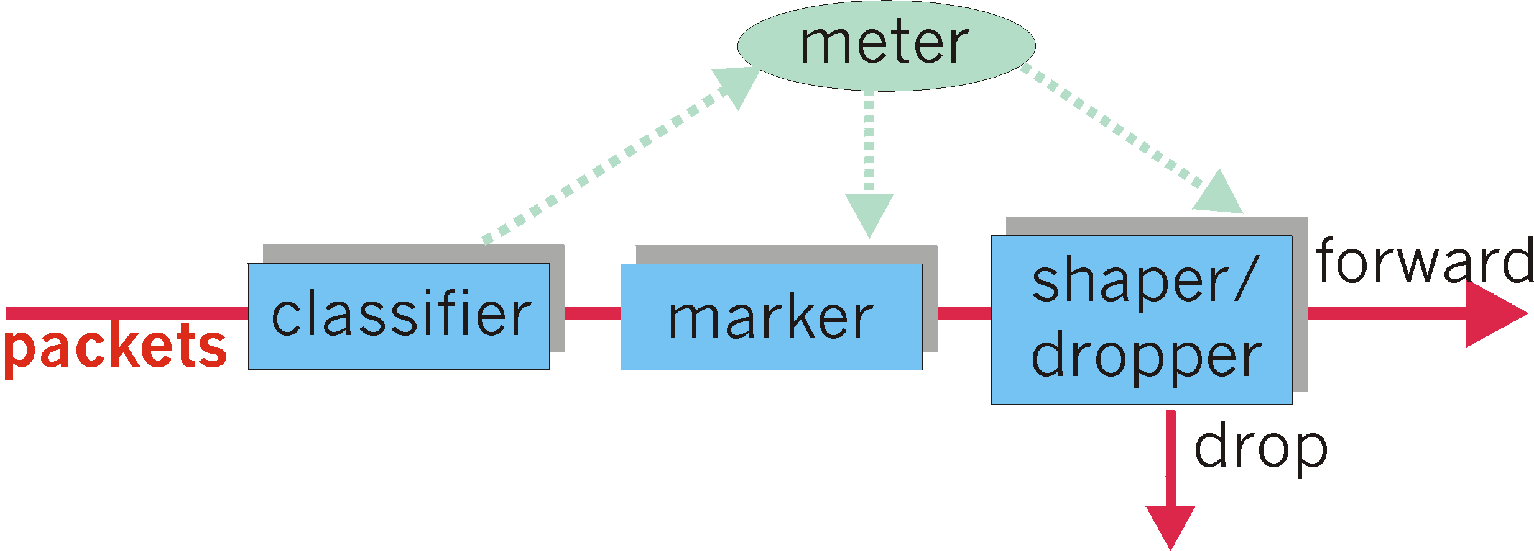
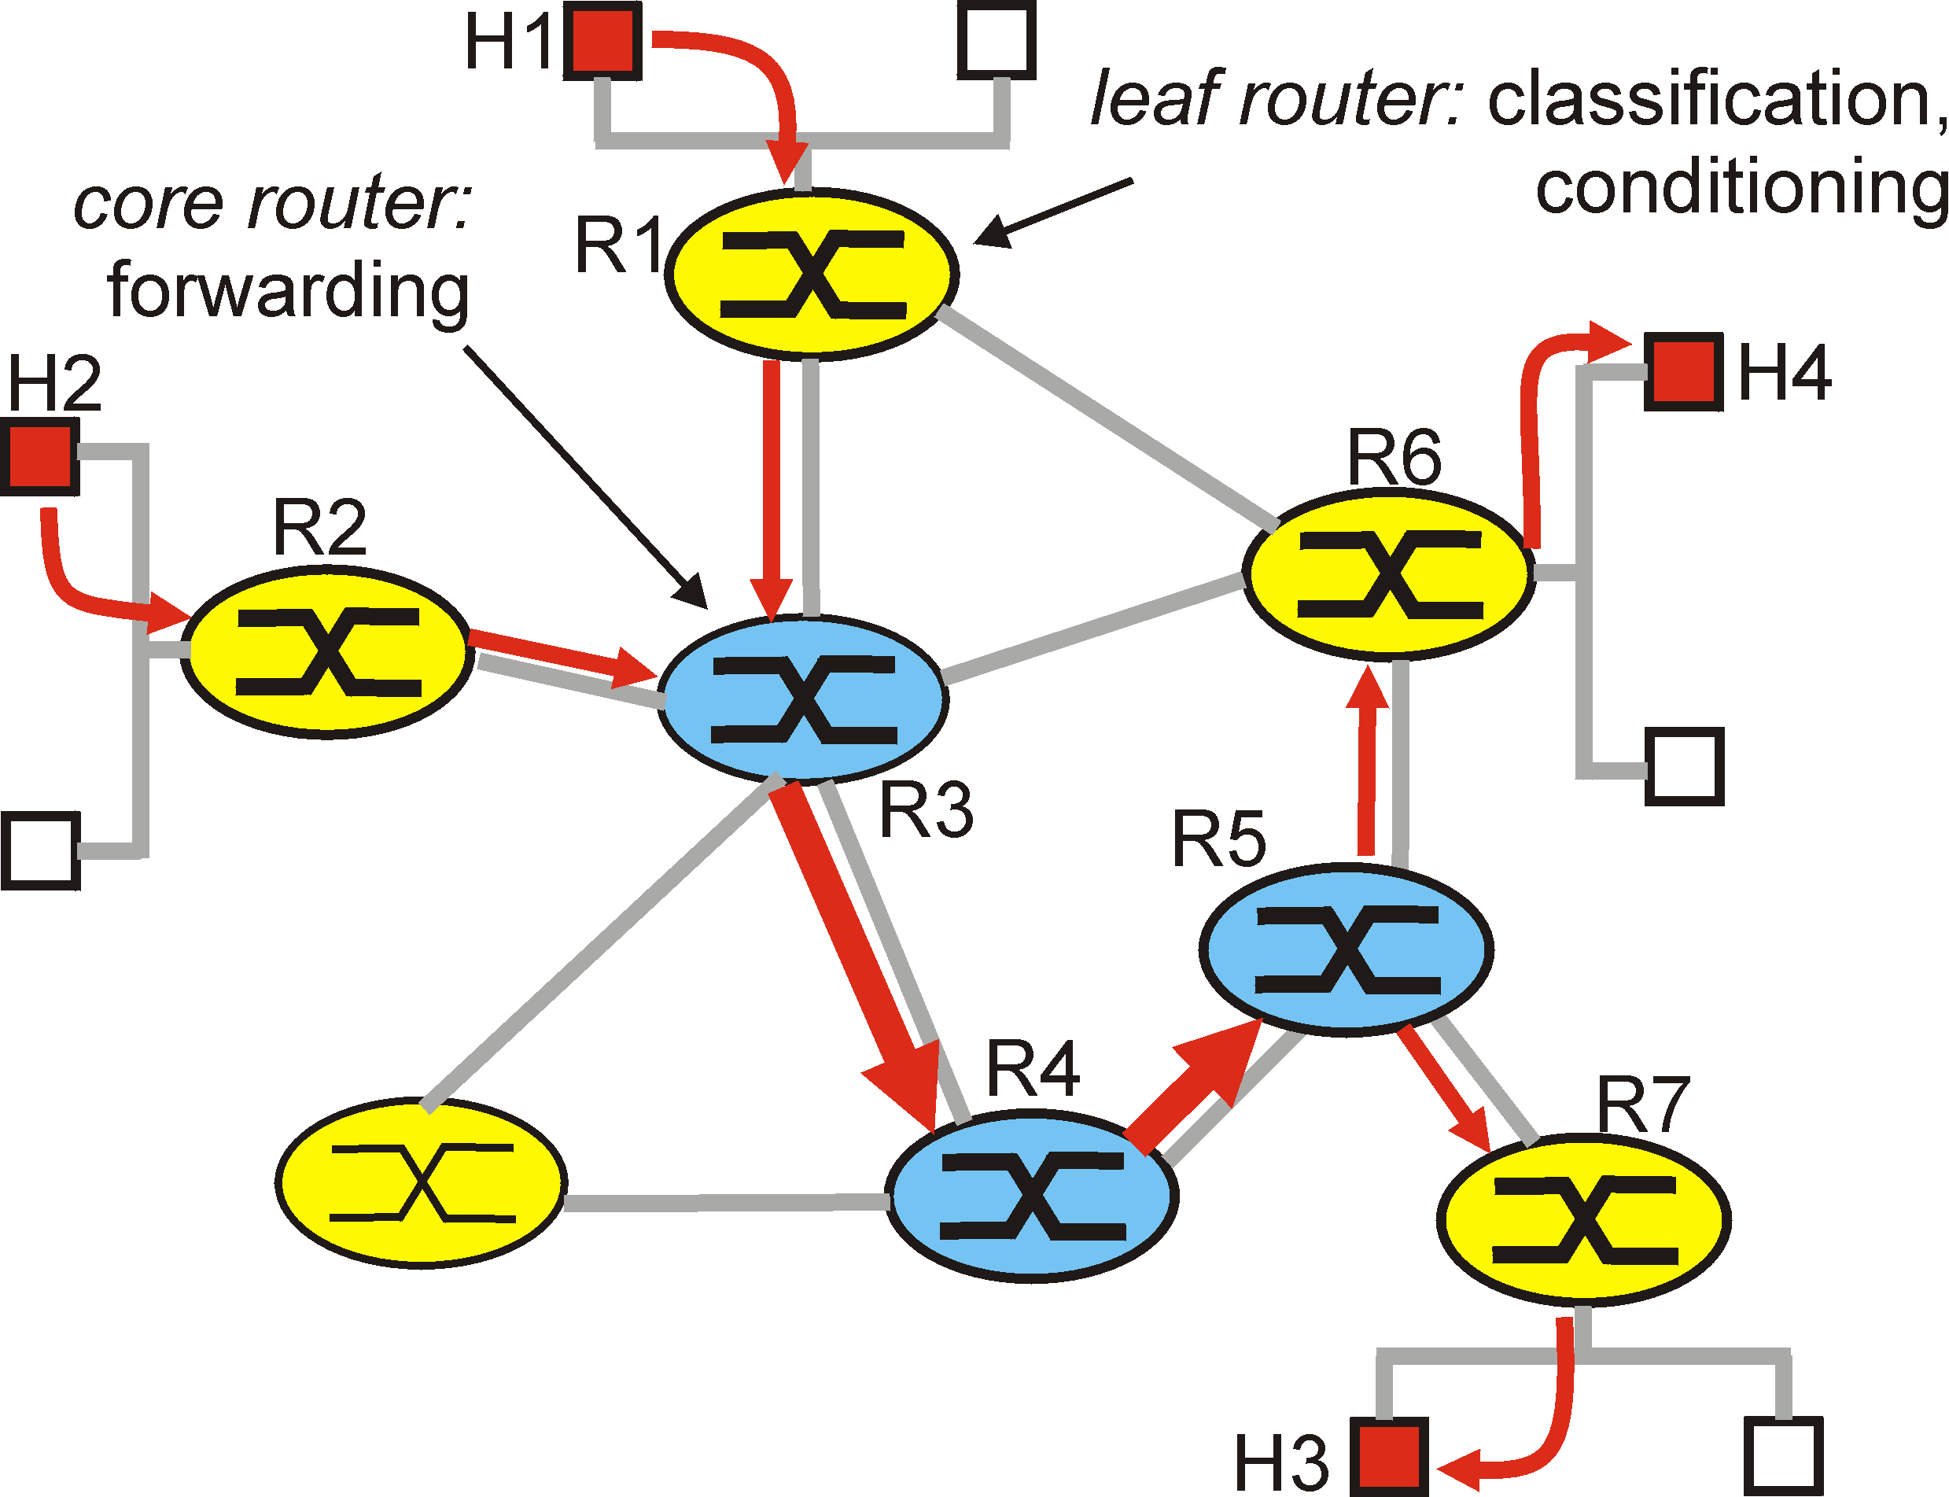
Differentiated Services(DS)
Edge functions: packet classification and traffic conditioning
Conditionning: meter, policer, dropper, marker, and shaper
packet marking, forwarding immediately/delayed/dropped
passes: VIP pass...
Core function: forwarding according to per-hop behavior
packet marking: the class of traffic(the behavior aggregate)
obviates the need to keep router state for individual source-destination pairs

Slide 32

Diffserv architecture
marking
r
edge router:
per-flow traffic management
marks packets as in-profile and out-profile
b
scheduling
.
.
.
core router:
per class traffic management
buffering and scheduling based on marking at edge
preference given to in-profile packets over out-of-profile packets
Slides made by F. Kurose and Keith W. Ross

Slide 33
Edge-router packet marking
profile: pre-negotiated rate r, bucket size b
packet marking at edge based on per-flow profile
rate r
b
user packets
possible use of marking:
class-based marking: packets of different classes marked differently
intra-class marking: conforming portion of flow marked differently than non-conforming one
Slides made by F. Kurose and Keith W. Ross

Slide 34
Per-connection QOS guarantees
basic fact of life: can not support traffic demands beyond link capacity
1 Mbps
phone
R1
R2
1 Mbps
phone
1.5 Mbps link
Principle 4
call admission: flow declares its needs, network may
block call (e.g., busy signal) if it cannot meet needs
Slides made by F. Kurose and Keith W. Ross

Slide 35



QoS guarantee scenario
resource reservation
call setup, signaling (RSVP)
traffic, QoS declaration
per-element admission control
request/
reply
QoS-sensitive scheduling (e.g., WFQ)
Slides made by F. Kurose and Keith W. Ross

Slide 36
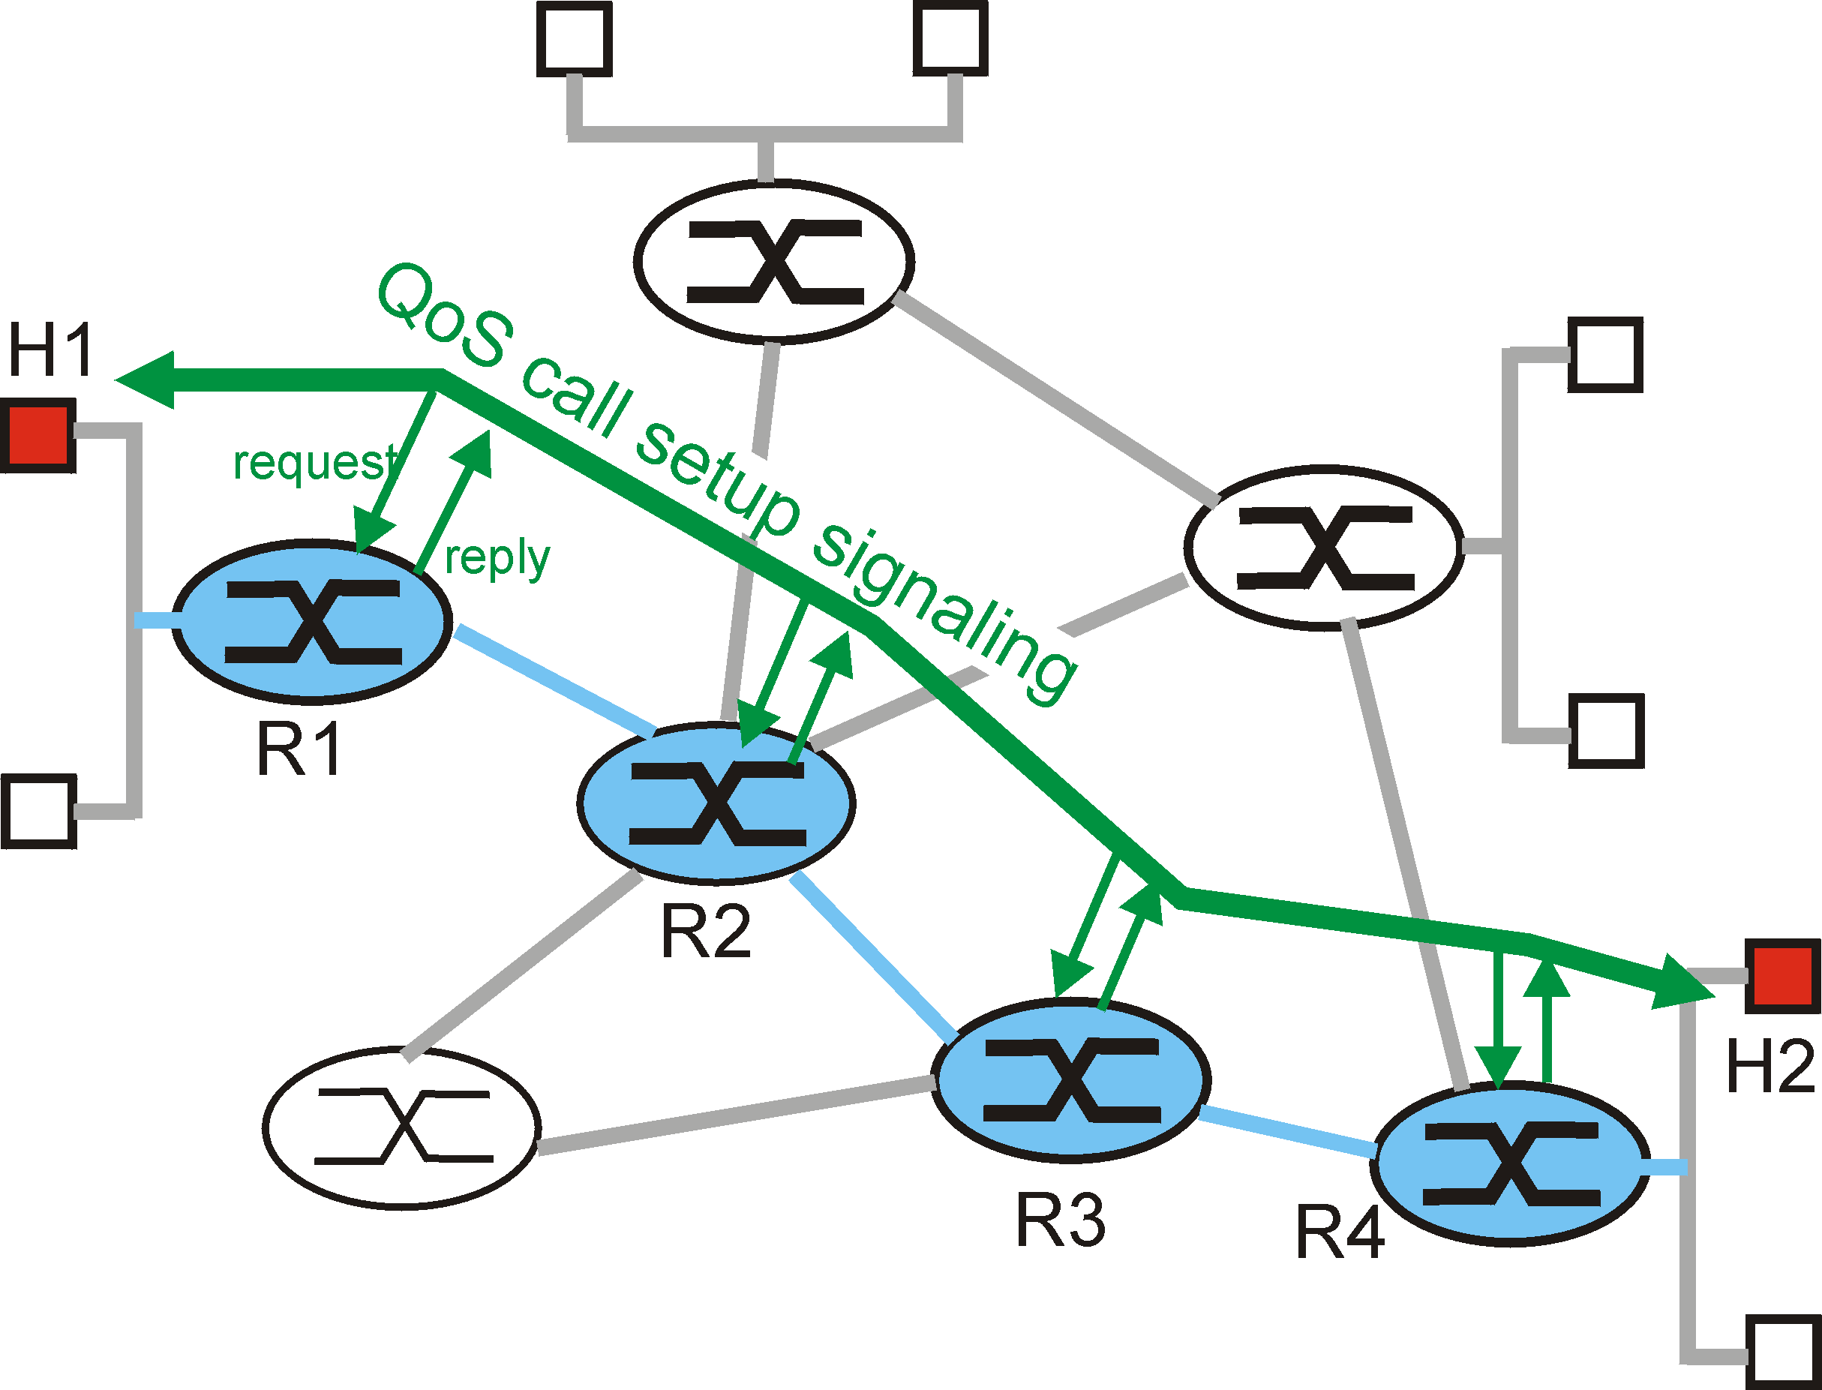
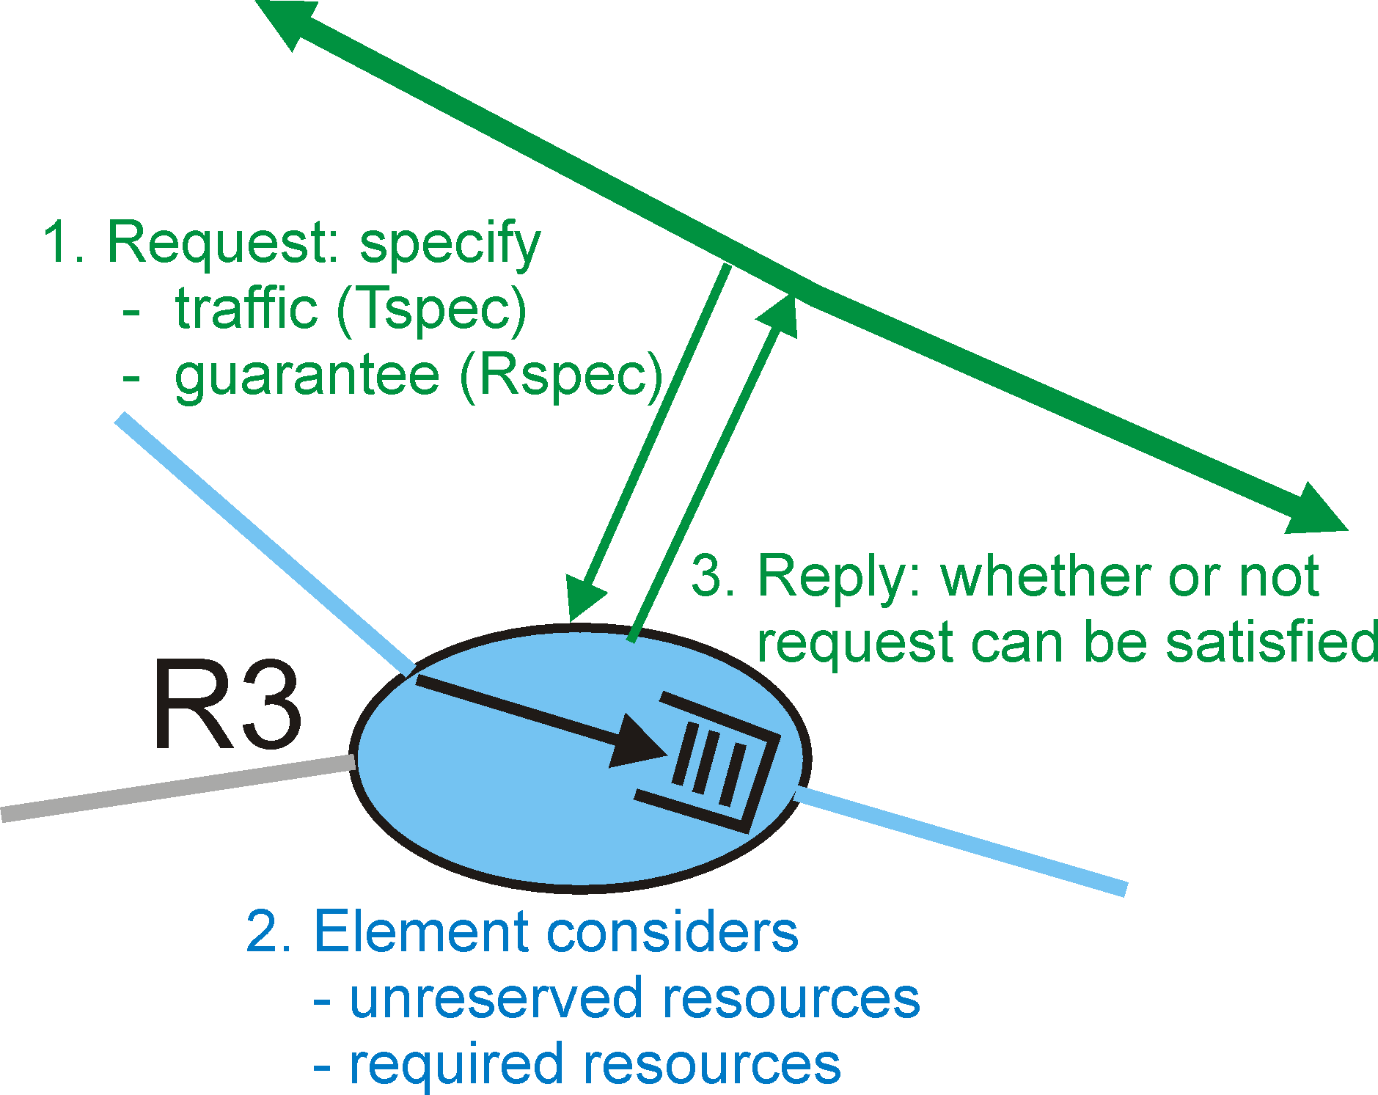
Resource Reservation (RSVP)
The call setup process and per-element call behavior

Slide 37
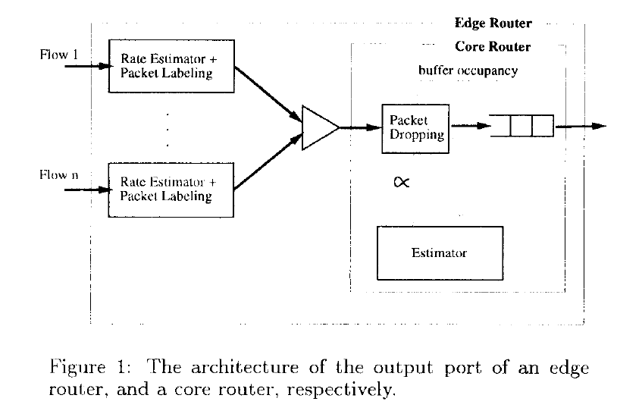
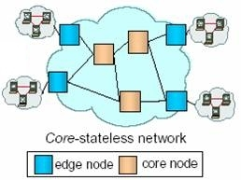
Core-Stateless Fair Queueing
WFQ is hard to implement at the core networks

Slide 38
Core-Stateless Fair Queueing
Ingress edge routers compute per-flow rate estimates and insert these estimates as labels into each packet header.
Measure arrival rate: EWMA
Core-routers: FIFO queueing with probabilistic dropping of packets
Use label and local measurement to control processing of packets (drop)
Estimated arrival rates from edge: r
Internal measure of fair-share: a
Forward the packet depending on dropping probability max(0,1-a/ri)
The service received by the flow at time t will be min(ri(t) ,a(t))
The total outgoing traffic from the router would be the ∑ (min(ri(t) ,a(t)) =C
The fraction of packet dropped from each flow is calculated by ((ri(t) - a(t))/ ri(t).
Labels changed on outbound flow with new post-drop arrival rate.
If there is congestion at core router, the packet labels need to be updated at the core router Lnew = min(Lold, a)
Outgoing rate is the minimum of incoming and the fair rate
Weighted CSFQ
Max(0,1- a* wi/r(i)) thus ∑wi min(a,r(i)/wi) =C

Slide 39
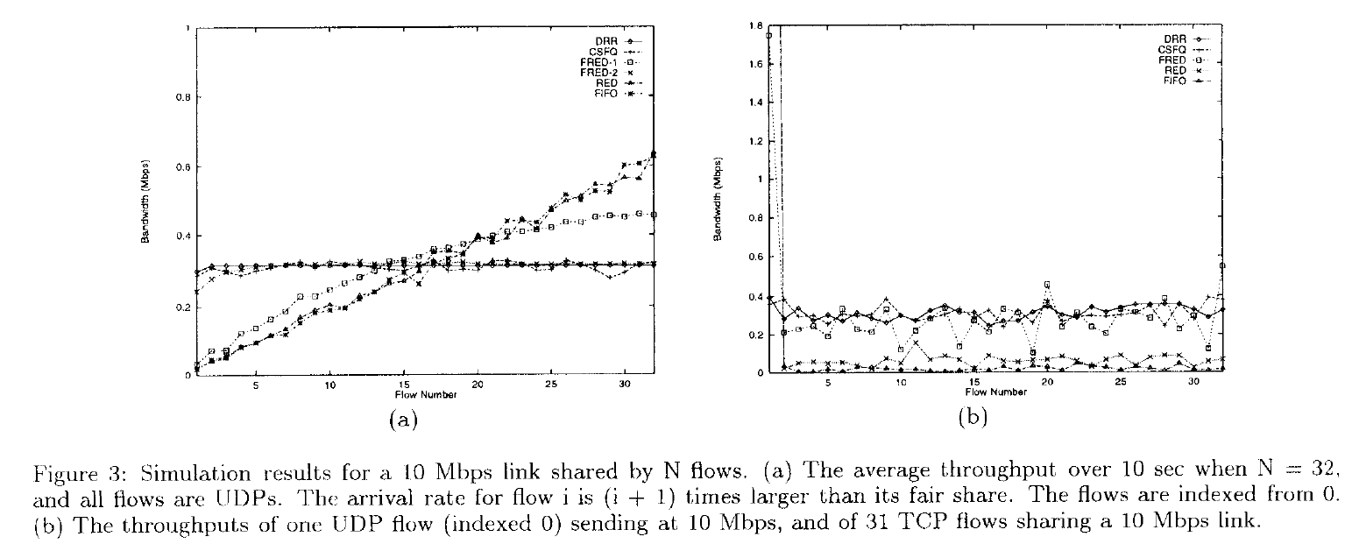
Edge – Core Router Architecture
Core-Stateless Fair Queueing: Achieving Approximately Fair Allocations in High Speed Networks

Slide 40
Reading Assignment
Van Jacobson , “Congestion Avoidance and Control”
Kevin Fall et al., “Simulation-based Comparisons of Tahoe, Reno, and SACK TCP”
Submit less than 1 page report online via KLMS by 6pm Oct. 5 which is the day before the lecture of Oct. 6 (Thur.)
Submit also hard copy report at the beginning of the lecture of Oct. 6 (Thur.) as attendance check and for discussion

Slide 41
Discussion: picked up randomly
Worst-case situations are not familiar in the network congestions. I think that there are a lot of heuristic algorithms similar to WF2Q. I wonder how they supposed the congestion situations and solve the problem
I wonder the ratio of the number of edge and core routers. CSFQ deals with only the core routers but the number of edge routers is not small, I guess. I also curious about the solutions of congestion control without fairness issues.
Then, how could it be possible for the researchers to have made the "popular belief" which was wrong? It is more than suspicious that GPS and WFQ was considered to be pseudo-identical by the researchers. At least, it should have been considered by the researchers that WFQ is good mechanism for fair queueing, and the ideal fair queueing will be based on GPS. Hence, the question here is that whether the authors exaggerated a bit or the popular belief was there indeed.

Slide 42
Discussion: picked up randomly
To identify mis-behaving (unfriendly), identifying those flows and, if possible, punishing them is core-router’s role so that it may be a burden to them. How can effectively detect unfriendly flows using core-routers in real networks?
It seems that when implementing this algorithm to the existing WFQ implemented routers, only a minor revision would be needed so that easy to apply this in real-network, but is this feasible approach in high-speed network? How can we improve the computation speed of required function values?
Meanwhile, the example shown in Figure 1, 2 is highly asymmetric bandwidth distribution across the sessions. Is this common phenomena in real network? It seems that if the weight between the sessions are quite similar to each other, WFQ and WF2Q may not that much differ from each other. In other words, is this approach only useful in highly asymmetric distribution of bandwidth?

Slide 43
Discussion: picked up randomly
Finally, the articles discusses punishment but the real challenge would be to make Internet protocols aware of their own punishment so that they can adapt and stop mis-behaving, for example.
As seen, selecting the queue with minimal virtual finish time is not easy. Especially in high-speed networks. Moreover, the amount of processing requiring to calculate weights and other things is not relevant in a high speed environment. Consequently, this is an example of a case where it fails to approximate GPS. Thus it could be a good idea to think of something else which would better fit our networks. Other experiments shown in the paper indicate that even though it usually performs almost as good as does GPS, sometimes its performance is slightly worst.

